Slide 1

Automated Planning
AI

Slide 2
What is Automated Planning?
⇝ finding plans (sequences of actions)
that lead from an initial state to a goal state
Here: classical planning
general approach to finding solutions for state-space search problems
classical = static, deterministic, fully observable
variants: probabilistic planning, planning under partial observability, online planning, . . .
“Planning is the art and practice of thinking before acting.”
P. Haslum

Slide 3
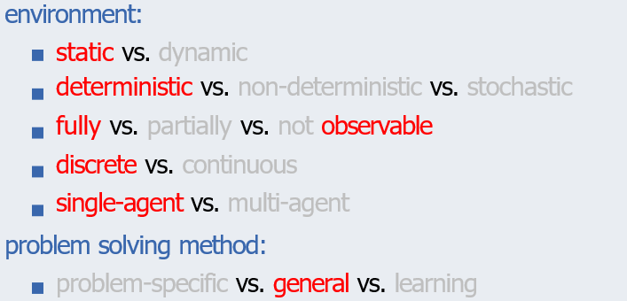
Classification
Automated Planning

Slide 4
Planning: Informally
given:
state space description in terms of suitable problem description language (planning formalism)
required:
a plan, i.e., a solution for the described state space (sequence of actions from initial state to goal)
or a proof that no plan exists
distinguish between
optimal planning: guarantee that returned plans are optimal, i.e., have minimal overall cost
suboptimal planning (satisficing): suboptimal plans are allowed

Slide 5
What is New?
Many previously encountered problems are planning tasks: blocks world
route planning in romania missionaries and cannibals 15-puzzle
New: we are now interested in general algorithms, i.e., the developer of the search algorithm does not know the tasks that the algorithm needs to solve.
⇝ no problem-specific heuristics! ⇝ input language to model the planning task

Slide 6
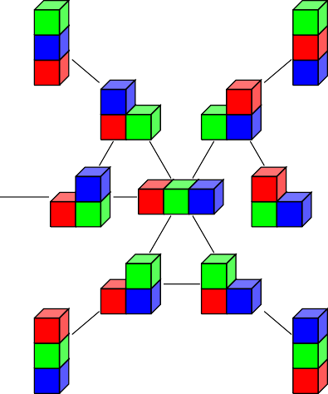


State Space
(action names omitted; initial state and goal can be arbitrary)
state spaces are (labeled, directed) graphs
terminology: predecessor, successor, applicable action, path, length, costs, reachable, solution, optimal solution

Slide 7
State Spaces with Declarative Representations
How do we represent state spaces in the computer?
previously: as black box
now: as declarative description
represent state spaces declaratively:
compact description of state space as input to algorithms ⇝ state spaces exponentially larger than the input
algorithms directly operate on compact description ⇝ allows automatic reasoning about problem: reformulation, simplification, abstraction, etc.

Slide 8
Compact Description of State Spaces
How to describe state spaces compactly?
Compact Description of Several States
introduce state variables
states: assignments to state variables
⇝ e.g., n binary state variables can describe 2^{n} states
transitions and goal are compactly described with a logic-based formalism
⇝ different variants: different planning formalisms

Slide 9
Summary
planning: search in general state spaces
input: compact, declarative description of state space

